Slide 1
Data Visualization
(From Theory to Practice)
Seungmin Jin
(dryjins@gmail.com)

Slide 2




Slide 3
Goals
Course objectives: Understanding visualization development from abstract concepts to implementation
The fundamental of data visualization development
The core concept of D3
The examples and practices of D3 with LLMs
Prerequisite: Programing

Slide 4



Textbook
Visualization Analysis and Design
The Book of Shaders
Data Visualization with D3, JavaScript, React - Full Course [2021] - YouTube
Beautifully Animate Points with WebGL and regl - Peter Beshai

Slide 5
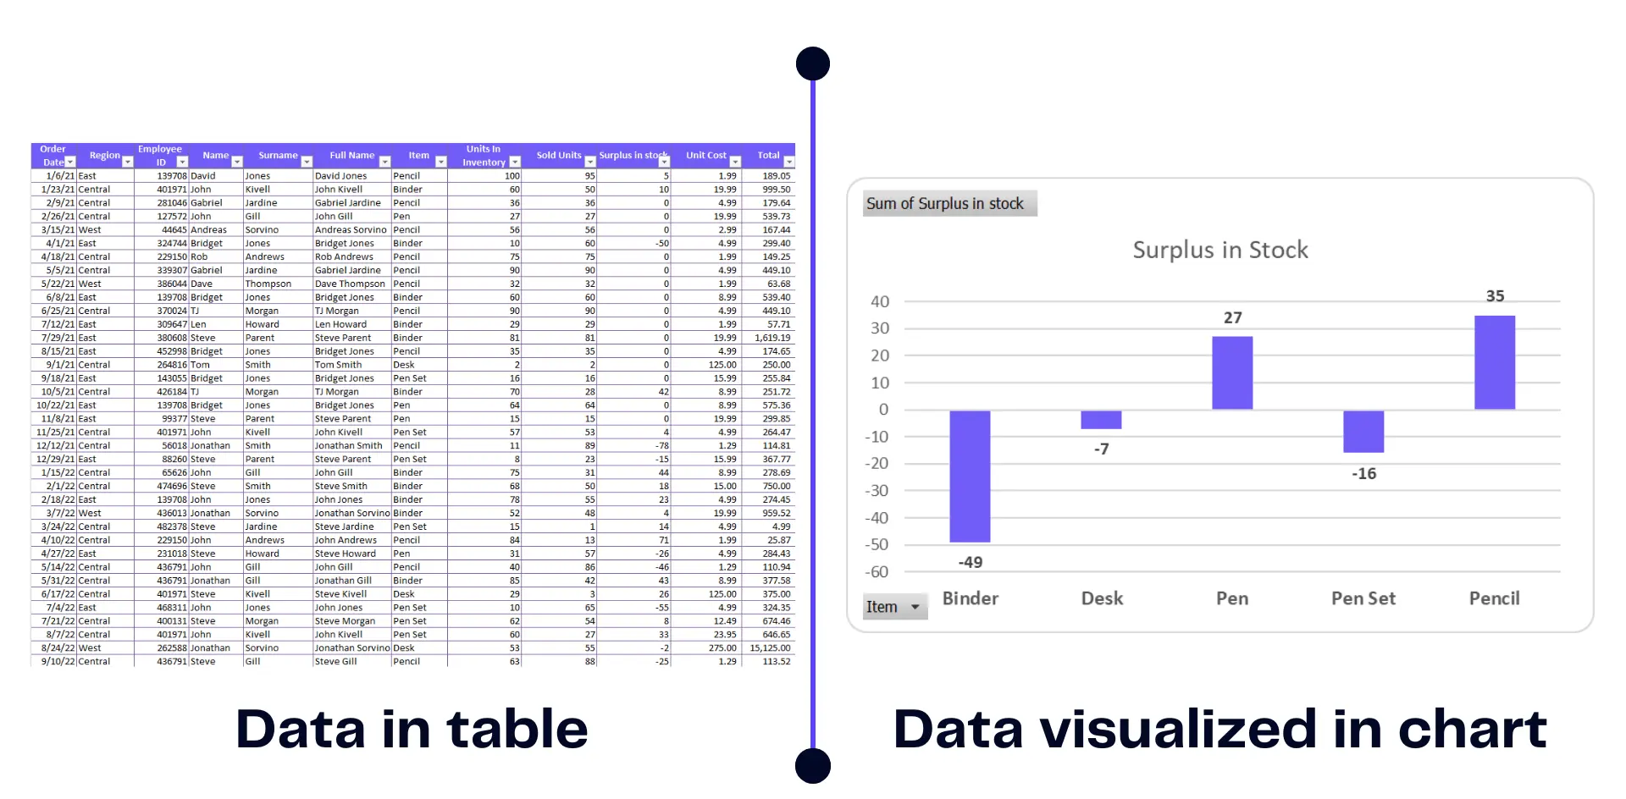
Data Visualization Fundamentals
NASA (1965) "Man is the lowest-cost, 150-pound, nonlinear, all-purpose computer system which can be mass-produced by unskilled labour".
Cognitive
Visual Perception
Workload

Slide 6
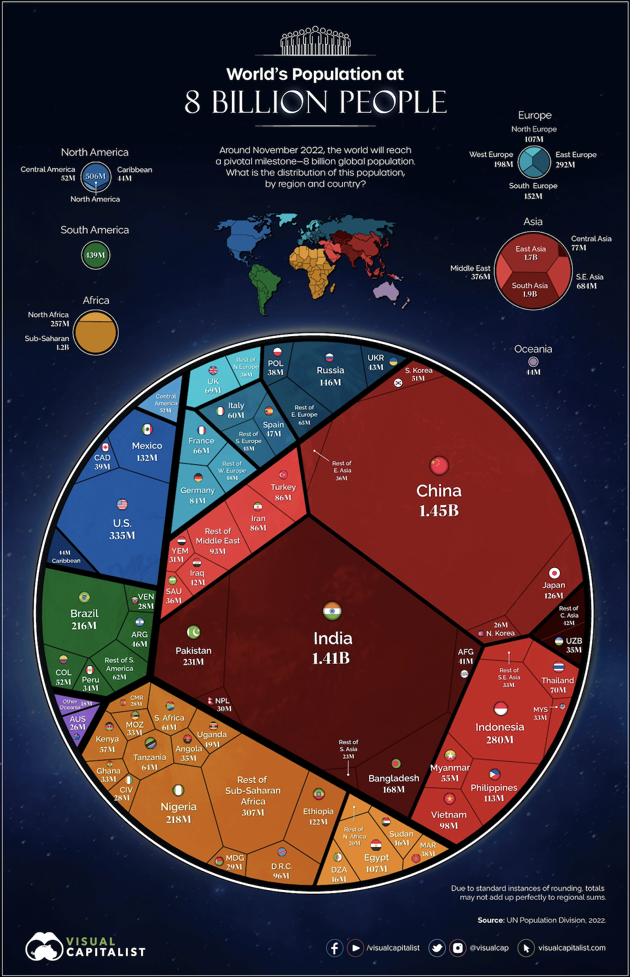
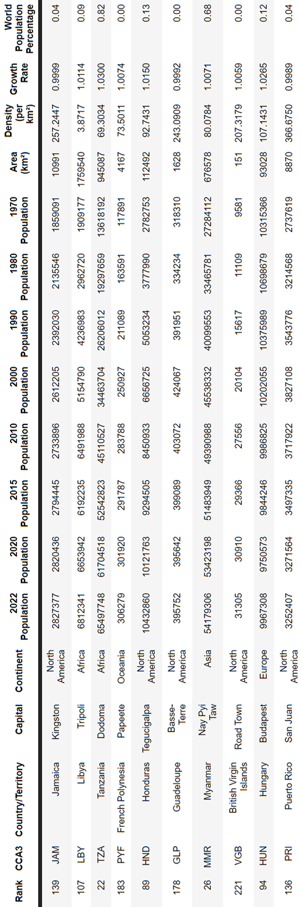
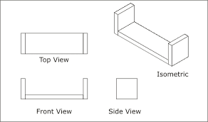
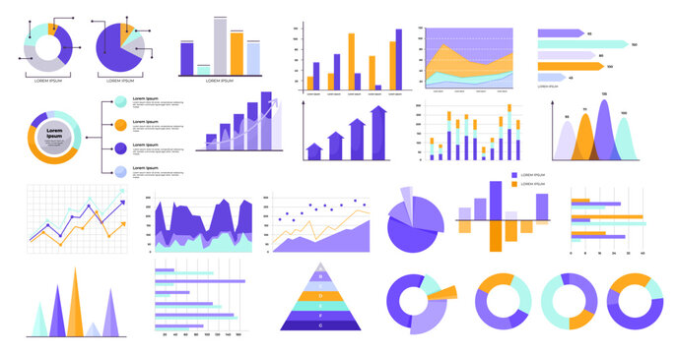
Data Visualization Fundamentals
Data
Data
Manipulation
Visual Mapping (Design)
Rendering
Visualization
Filtering
Transform
Outliers
Charts
Visual Encoding
Layout
Views
Interaction
Optimization

Slide 7
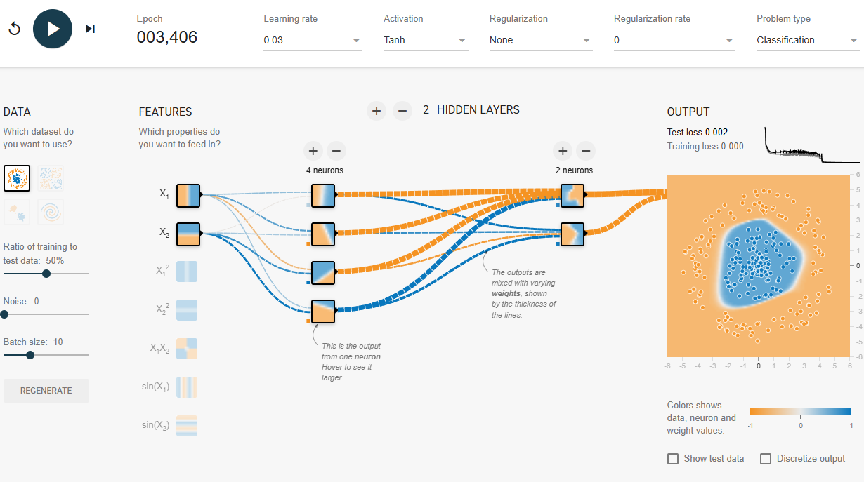
Data Visualization Fundamentals
Data
Data
Manipulation
Visual Mapping (Design)
Rendering
Visualization
A Neural Network Playground

Slide 8
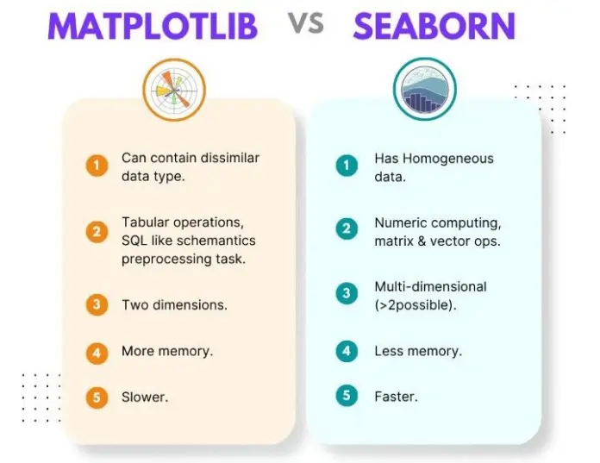
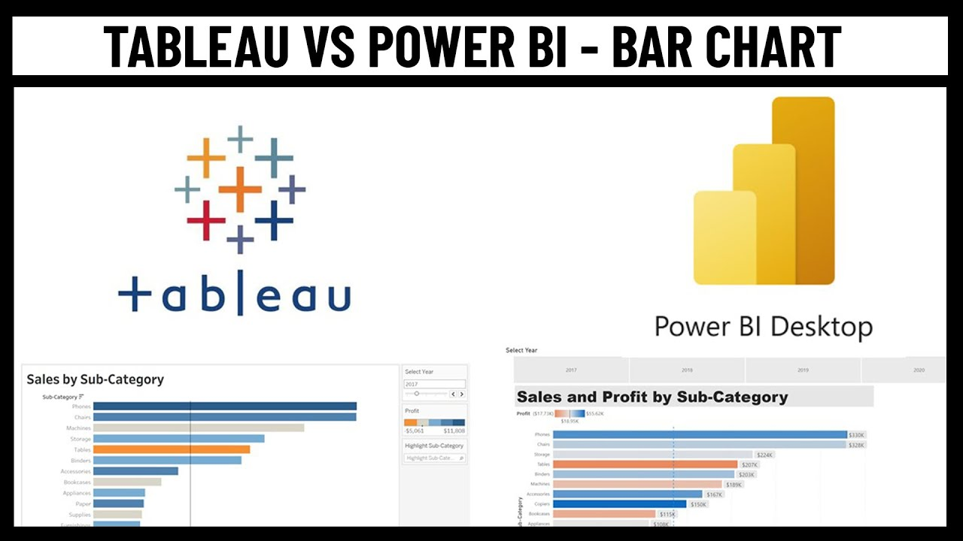
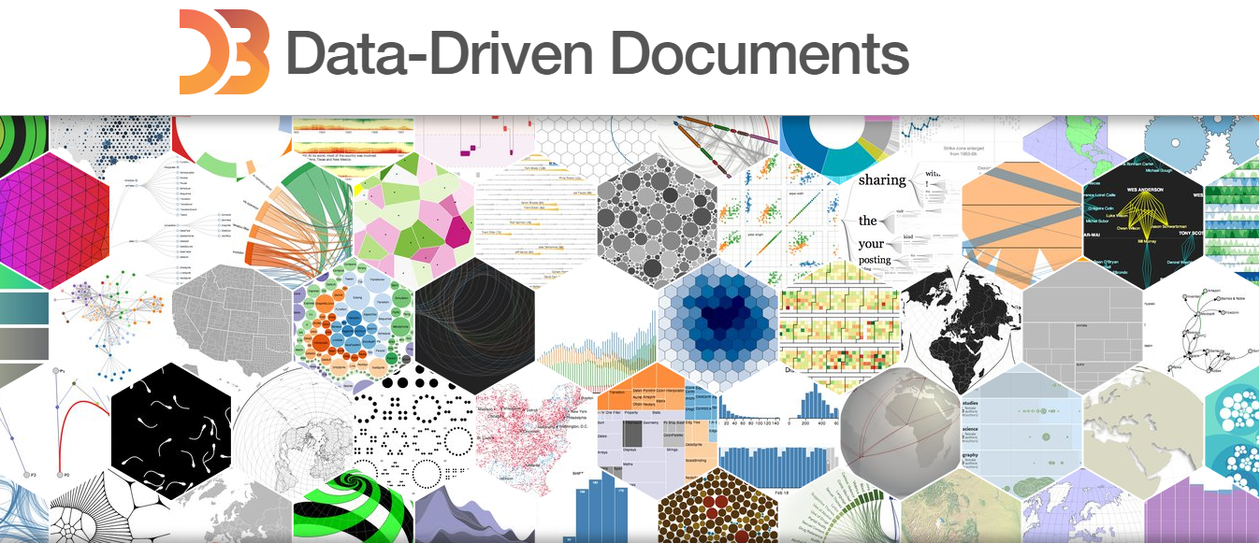
Frameworks
Opensource
Industrial Level
Flexible Customization

Slide 9
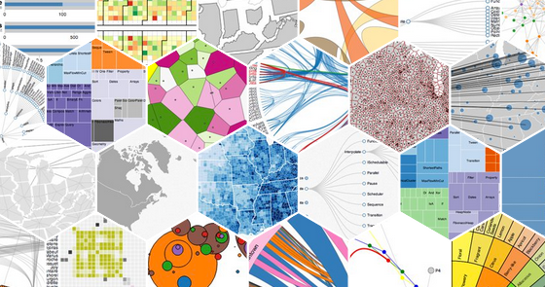
D3 Overview
D3.js is a JavaScript library for manipulating documents based on data.
Data-Driven Documents (D3)
Provide unified interface for SVG, DOM and canvas
You can access tons of example for visualizations!
https://d3js.org/
Data
Data
Manipulation
Visual Mapping (Design)
Rendering
Visualization
D3 Support

Slide 10

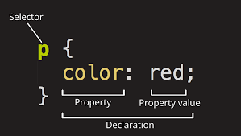
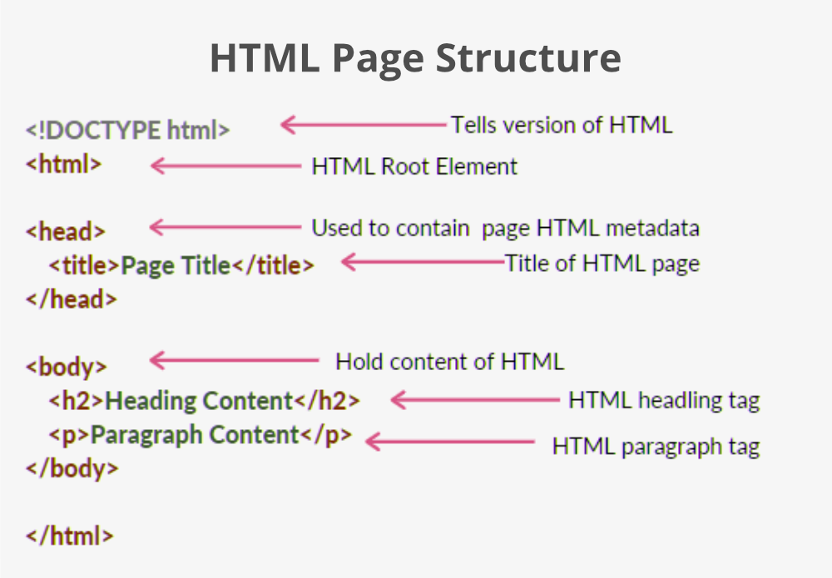
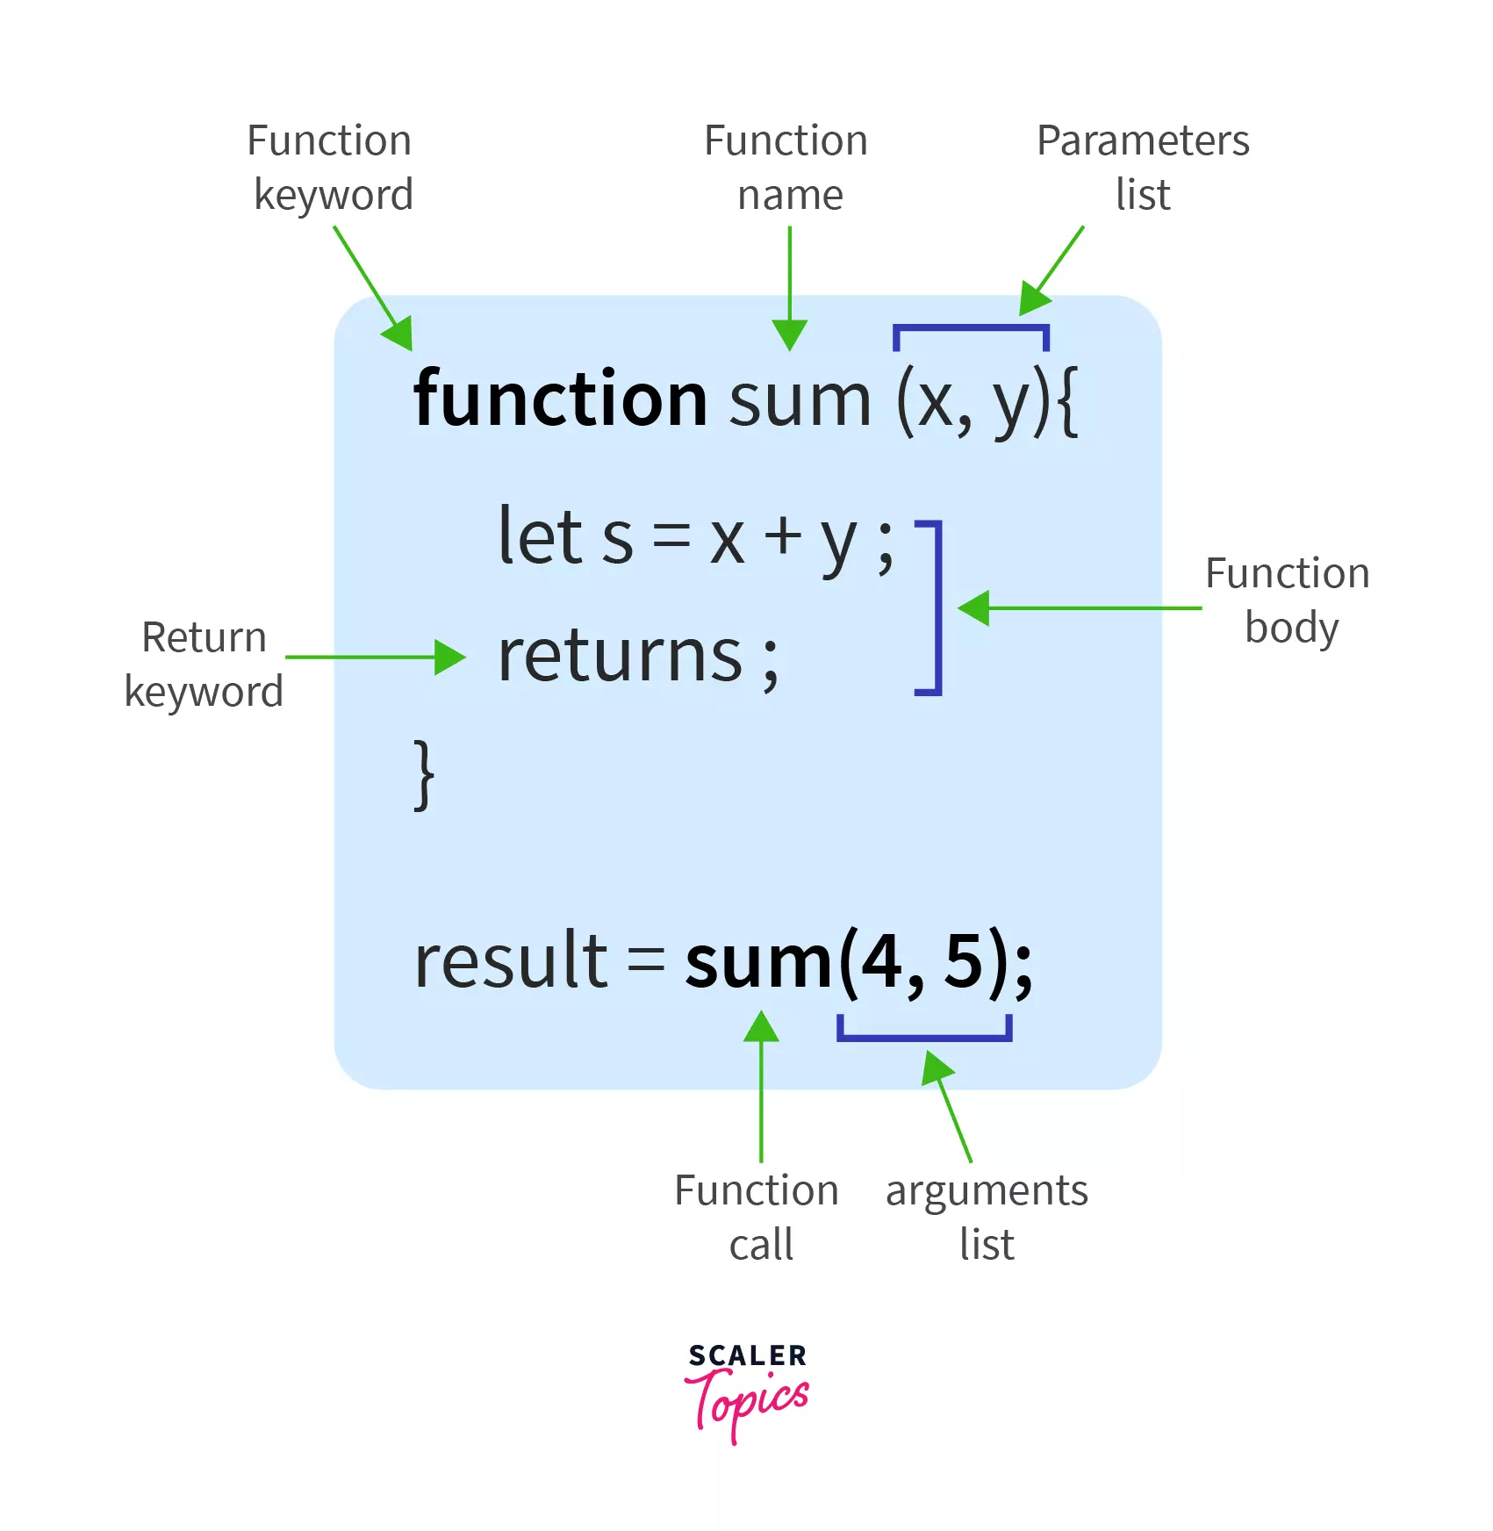

HTML5 and Web Browser
Language for display!
Document Object Model
CSS (Cascading Style Sheets)
HyperText Markup Language (HTML)
read
Javascript (Functions)
rendering
Document Object Model (DOM) Elements

Slide 11
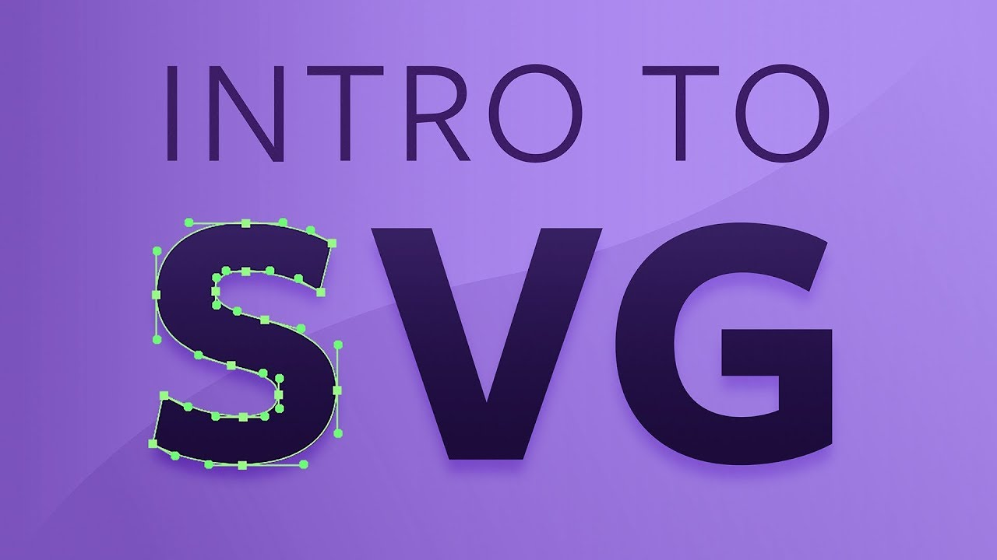
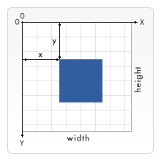
Rendering
We can visualize anything with HTML and CSS, so HTML provides…
Rendering One Million Datapoints with D3 and WebGL
Scalable Vector Graphics (SVG - DOM)
HTML Canvas
CPU
Canvas 2D
GPU
WebGL
SVG defines the graphics in XML format
Every element and every attribute in SVG files can be animated
SVG requires incremental space complexity for each elements (3000 max)
A mere container for graphics.
You must use JavaScript to actually draw the graphics.
Canvas require fixed space complexity based on the height and width.

Slide 12
Scalable Vector Graphics (SVG)
SVG is defined using markup code similar to HTML.
SVG elements don't lose any quality when they are resized.
SVG elements can be included directly within any HTML document or dynamically inserted into the DOM with JS.
Before you can draw SVG elements, you have to add an <svg> element with a specific width and height to your HTML document, for example: <svg width="500" height="500"></svg> .
The SVG coordinate system places the origin (0/0) in the top-left corner of the svg element.
SVG has no layering concept or depth property. The order in which elements are coded determines their depth order.

Slide 13
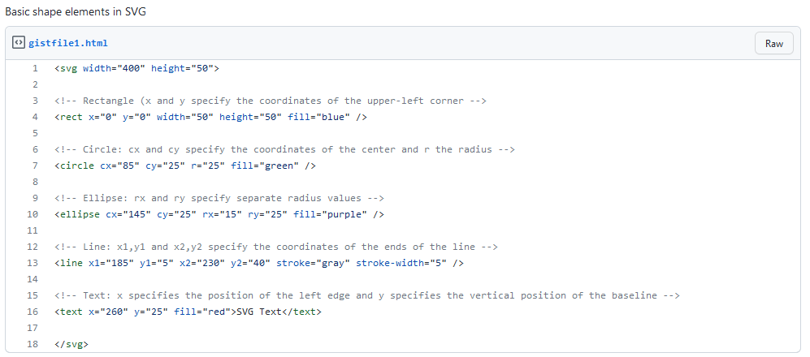
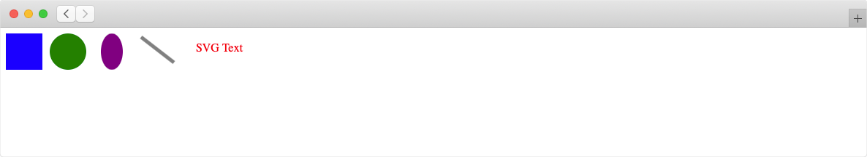
Scalable Vector Graphics (SVG)
Rect, Circle, Ellipse, Line and Text
https://gist.github.com/dryjins/75de87dfa8c6e28d37683cfdc3cf501a
result

Slide 14
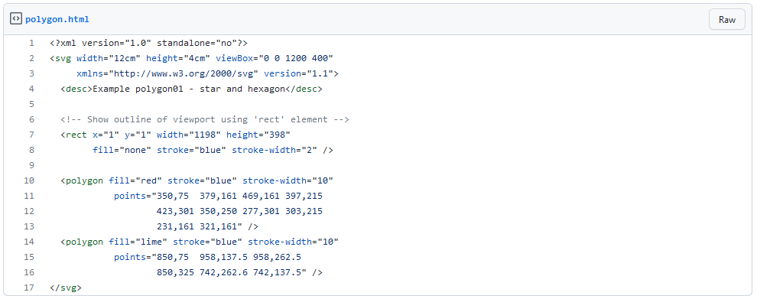

Scalable Vector Graphics (SVG)
Polygon
Define the position to connect polygon,
The order matters.
https://gist.github.com/dryjins/d5a1a5bcac96f4f06c3da3358b6fb931
result

Slide 15
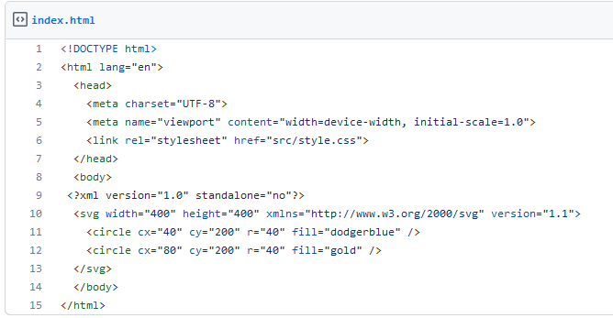
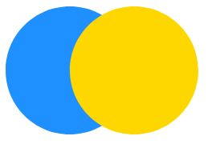
Scalable Vector Graphics (SVG)
Depth order = Document order
3.3 Rendering Order (SVG specification version 1.1)
Elements in an SVG document fragment have an implicit drawing order, with the first elements in the SVG document fragment getting "painted" first. Subsequent elements are painted on top of previously painted elements.
result
https://gist.github.com/dryjins/160aeae7253cabe8c16b5b80361de90e

Slide 16
D3 Design
Data Driven Documents
Canvas
SVG
DOM
Data
D3
Pixels
DOM
Visualization
data
selection
DOM element
data
selection
DOM element
data
selection
DOM element
data
selection
DOM element

Slide 17
D3 Design
Core Elements
Document Selection: d3.select("#visualization")
(Canvas or SVG) Container Creation: Establishing visualization canvas
Data Loading & Processing: Using d3.csv() and data transformation
Scales: Mapping data domains to visual ranges
Axes: Creating visual reference system
Data Binding: Associating data with DOM elements
Enter-Update-Exit Pattern: Managing data-driven element lifecycle
Modern Join Pattern: Simplified approach for enter/update/exit
Transitions: Animating changes in the visualization
Interactivity: Handling user events and dynamic behavior
The structure follows the general "Setup → Data → Scales → Axes → Elements → Interactions" pattern that forms the foundation of most D3.js visualizations.

Slide 18
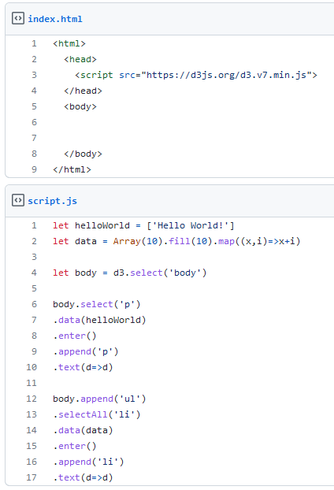
D3 Basic
Selection : select, append and selectAll
The select() method uses CSS selectors as input to grab page elements. It will return a reference to the first element in the DOM that matches the selector.
In our example we have used d3.select('body') to select the first DOM element that matches our CSS selector, body. Once an element is selected - and handed off to the next method in the chain - you can apply operators. These D3 operators allow you to get and set properties, styles, and content (and will again return the current selection).
Alternatively, if you need to select more than one element, use selectAll().
https://gist.github.com/dryjins/a9179e0d793358961c180f910beaf01f

Slide 19
D3 Basic
Selection : select, append and selectAll
After selecting a specific element or multiple elements, we can apply an operator, such as .append('p')
The append() operator adds a new element as the last child of the current selection. We specified "p" as the input argument, so an empty paragraph has been added to the end of the HTML body. The new paragraph is automatically selected for further operations.
At the end, we use the text() operator to insert a string between the opening and closing tags of the current selection (<p></p>).
result
10
11
12
13
14
15
16
17
18
19
Hello World!
Dynamic Properties
If you want access to the corresponding values from the dataset, you have to change anonymous functions. For example, we can change such a function inside the text() operator to change the text.
https://gist.github.com/dryjins/a9179e0d793358961c180f910beaf01f

Slide 20
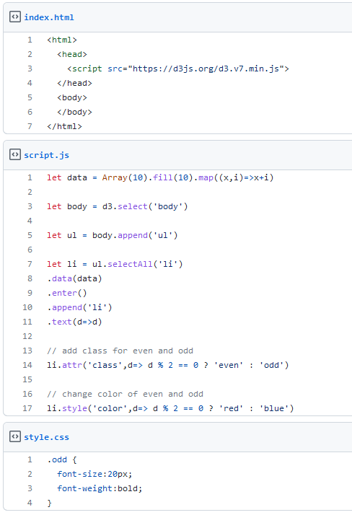
D3 Basic
HTML attributes and CSS properties
result
we can get and set different properties and styles - not only the textual content. This becomes very important when working with SVG elements.
We use D3 to set the HTML class, and color for odd and even numbers,
The font-weight and size defined in style.css file for the odd.
The font color which depends on the individual array value.
https://gist.github.com/dryjins/32422667974f39f1ef56f9272e868521
10
11
12
13
14
15
16
17
18
19

Slide 21
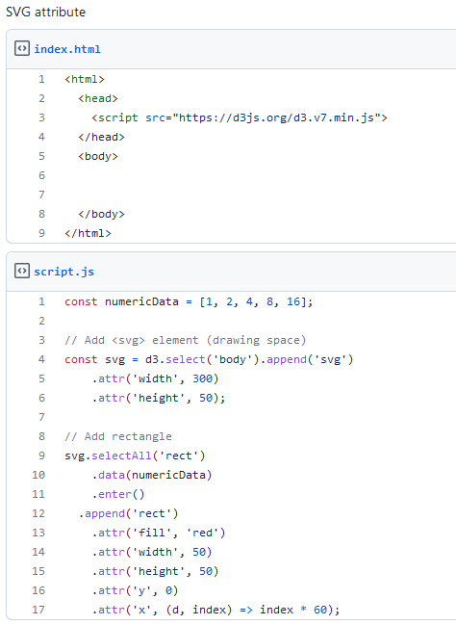

D3 Basic
HTML attributes and CSS properties for SVG
We have appended SVG elements to the DOM tree in our second example.
This means that we had to create the SVG drawing area first. We did this with D3 and saved the selection in the variable svg.
It is crucial to set the SVG coordinates of visual elements. If we don't set the x and y values, all the rectangles will be drawn at the same position at (0, 0).
By using the index, of the current element in the selection, we can create a dynamic x property and shift every newly created rectangle 60 pixels to the right.
https://gist.github.com/dryjins/30e8d4504af95593d19378b8d3eb9333
result

Slide 22
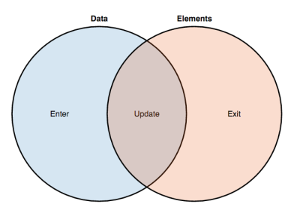
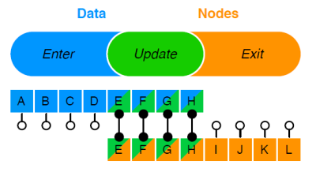
D3 Data Binding (join)
Enter, Update, and Exit
= dom elements
Any changes of DOM trigger redrawing from the web browser which is very expensive for the cost-wise.
Enter, Update, Exit triggers the browser redawning DOM elements only if necessary.
D3 provides update and exit at the selection level then apply the changes to the DOM later to redraw the changes at one time.
These also provide the fancy way to animate the changes of visualization dynamically. We will cover this part later.

Slide 23
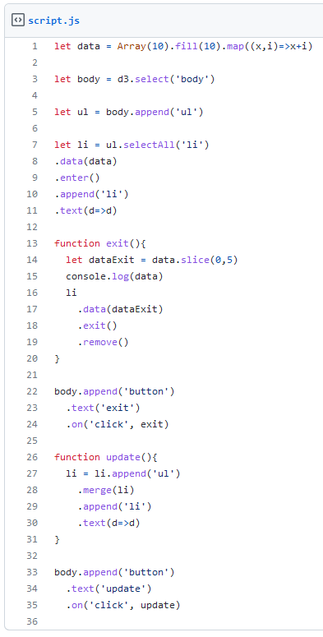
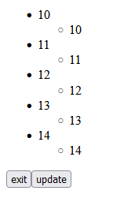
D3 Data Binding (join)
Merge, and Exit
Merge is combination of update and enter which append new elements.
From previous our example, lets’ slice 5 items from the list so that remains only 10 to 14.
Select changed <li> and append new sublist <ul> and join itself
You can test the process by pressing exit and update buttons
https://gist.github.com/dryjins/180d29ee3a2def213b08dd29f8a5d6a2
result

Slide 24
D3 External Data Loading
Instead of typing the data in a local variable, which is only convenient for very small datasets, we can load data asynchronously from external files. The D3 built-in methods make it easy to load JSON, CSV, and other files.
CSV (Comma Separated Values)
CSV is a file format which is often used to exchange data. Each line in a CSV file represents a table row and as the name indicates, the values/columns are separated by a comma.
JavaScript Object Notation (JSON)
JSON is a standard text-based format for representing structured data based on JavaScript object syntax. It is commonly used for transmitting data in web applications.
In a nutshell: The use of the right file format depends on the data - JSON should be used for hierarchical data and CSV is usually a proper way to store tabular data.
a,b,c
1,2,3
4,5,6
[
{“a”:1, “b”:2, “c”:3},
{“a”:4, “b”:5, “c”:6}
]
=

Slide 25
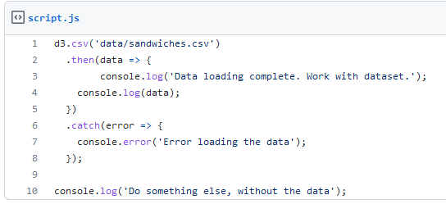
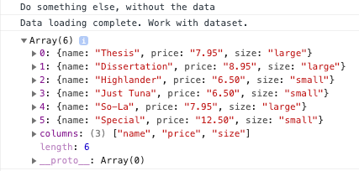
D3 External Data Loading
Instead of typing the data in a local variable, which is only convenient for very small datasets, we can load data asynchronously from external files. The D3 built-in methods make it easy to load JSON, CSV, and other files.
Why do we need an asynchronous execution?
Reading a file from the disk or an external server usually takes a while. Hence, we are using an asynchronous execution: We don't have to wait and stall, instead we can proceed with further tasks that do not rely on the dataset. After receiving a notification that the data loading process is complete, the callback function then() is executed.
name, price, size
Thesis, 7.95, large
Dissertation ,8.95, large
Highlander ,6.50, small
Just Tuna ,6.50, small
So-La, 7.95, large
Special, 12.50, small
sandwiches.csv
Note that the later executed first because of the asynchronous execution

Slide 26
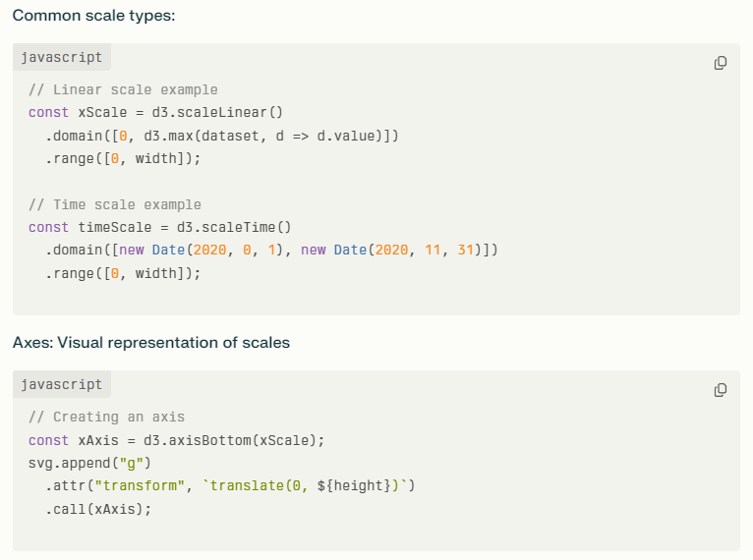
Scales and Axes
Scales: Mapping functions
Convert data domain to visual range
Handle the mathematical heavy-lifting

Slide 27
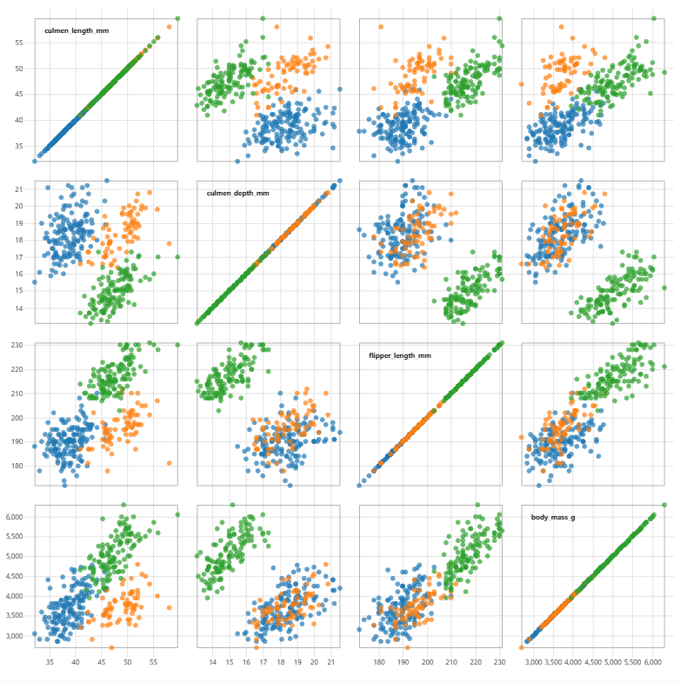
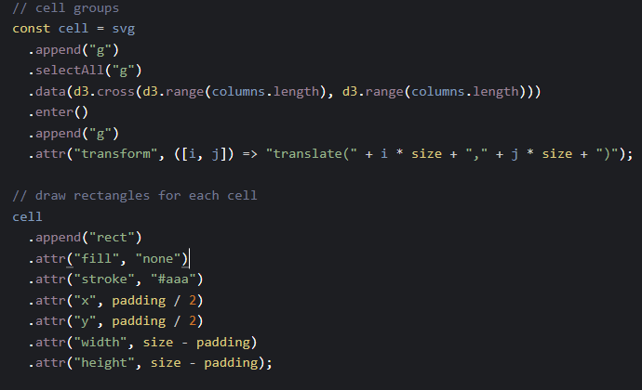
Interaction (Transition)
Brushable Scatterplot Matrix / D3 | Observable (observablehq.com)

Slide 28
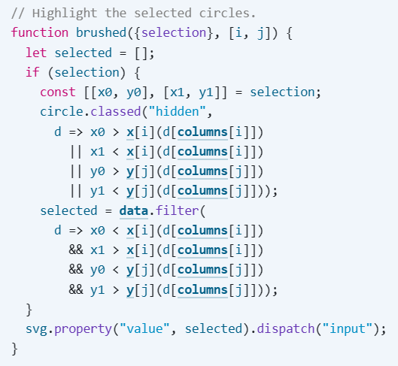
Interaction (Transition)
Brushable Scatterplot Matrix / D3 | Observable (observablehq.com)

Slide 29
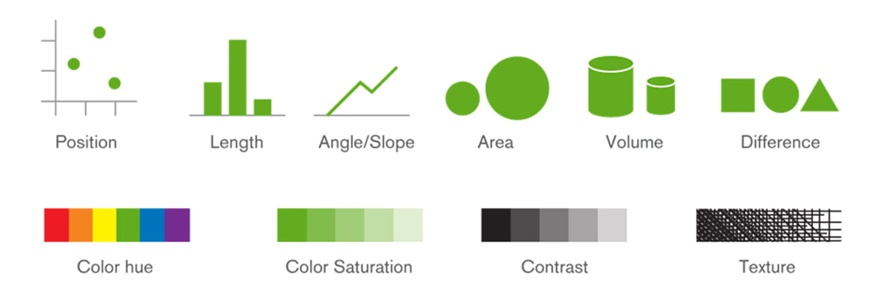
D3-shape (Visual Encoding)

Slide 30
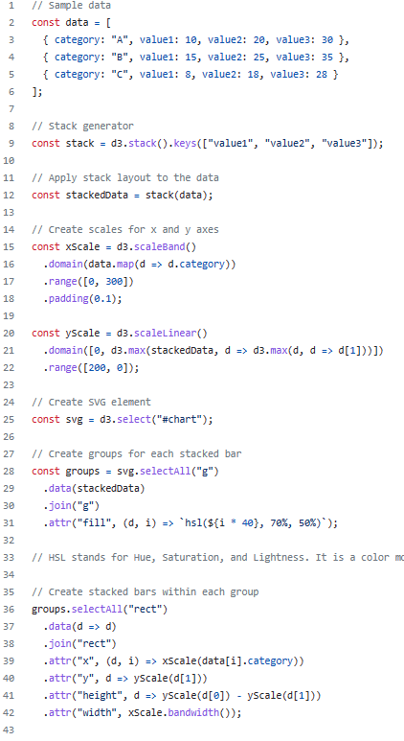
D3.stack (d3-shape)
stack · GitHub
The line const stack = d3.stack().keys(["value1", "value2", "value3"]); creates a stack generator function using the d3.stack() method from the d3-shape module in D3.js.
The d3.stack() function takes an array of data and returns a new array representing the stacked layout of the data. The .keys(["value1", "value2", "value3"]) method call specifies the keys (or property names) in the data objects that will be used for stacking.
In the given example, the resulting stack variable is a stack generator function that is ready to be applied to your data. When the generator function is invoked with the data, it will calculate the positions for each stacked segment based on the provided keys.
stackedData
[
[ [0,10], [0,15], [0,8] ],
[ [10,30], [15,40], [8,26] ],
[ [30,60], [40,75], [26,54] ]
]

Slide 31
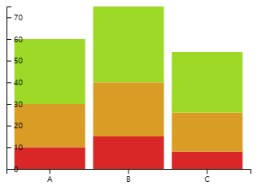
D3.stack (d3-shape)
HSL stands for Hue, Saturation, and Lightness
[
[ [0,10], [0,15], [0,8] ],
[ [10,30], [15,40], [8,26] ],
[ [30,60], [40,75], [26,54] ]
]

Slide 32
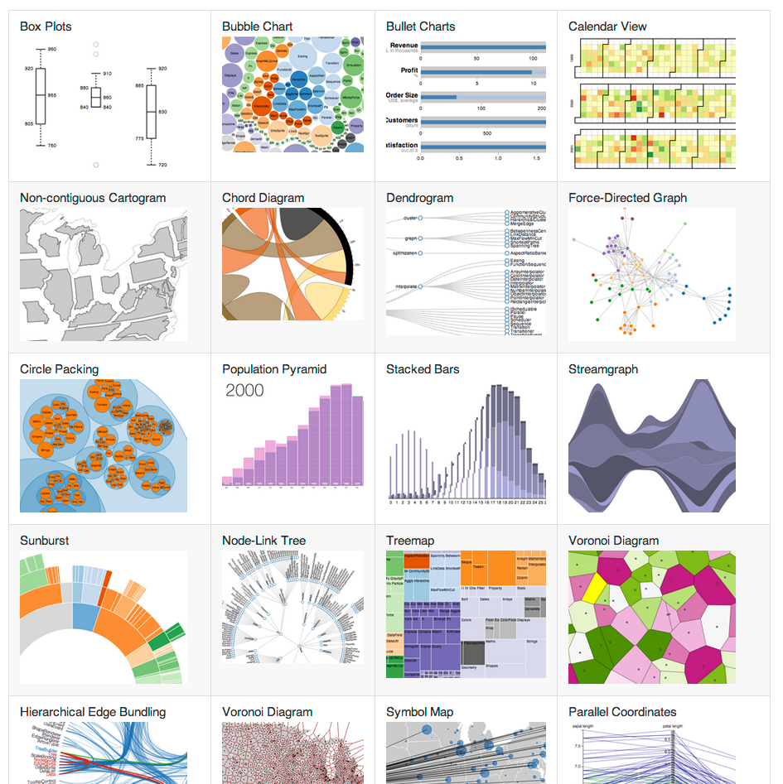
D3-shape
“D3js provides the translation of code for SVG and canvas.”
d="M150 0 L75 200 L225 200 Z"
SVG <path>
D3JS
context.moveTo(0, 0);
context.lineTo(200, 100);
context.stroke();
Canvas

Slide 33
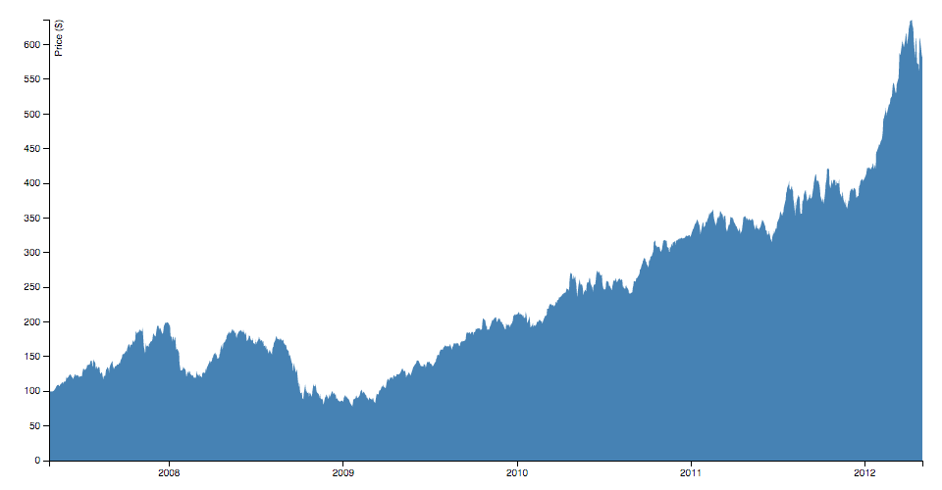
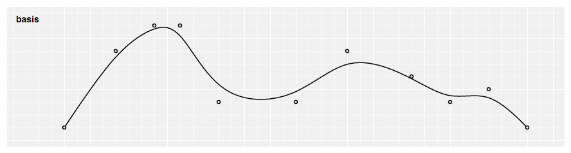
D3-shape
D3-shape
Arcs
Pies
Lines
Areas
Curves
Custom Curves
Links
Symbols
Custom Symbol Types
Stacks
B-spline

Slide 34
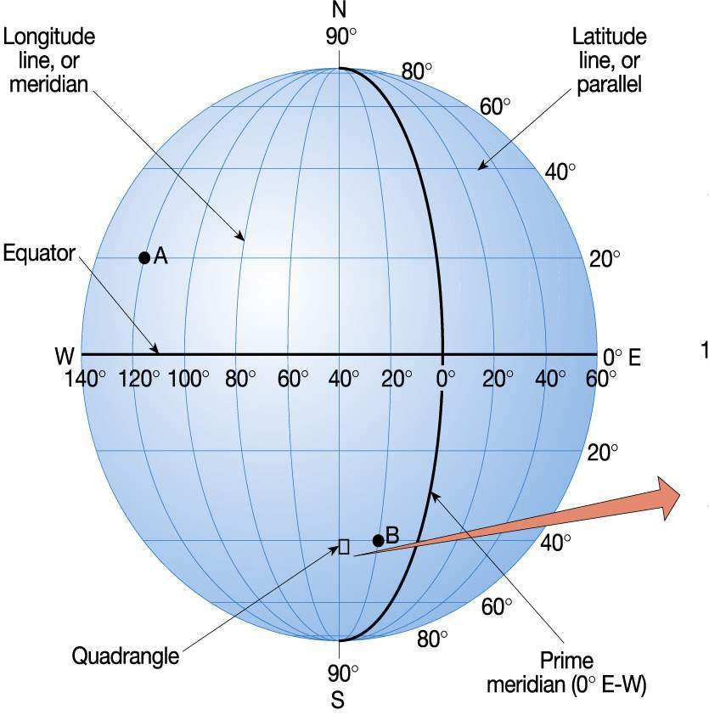
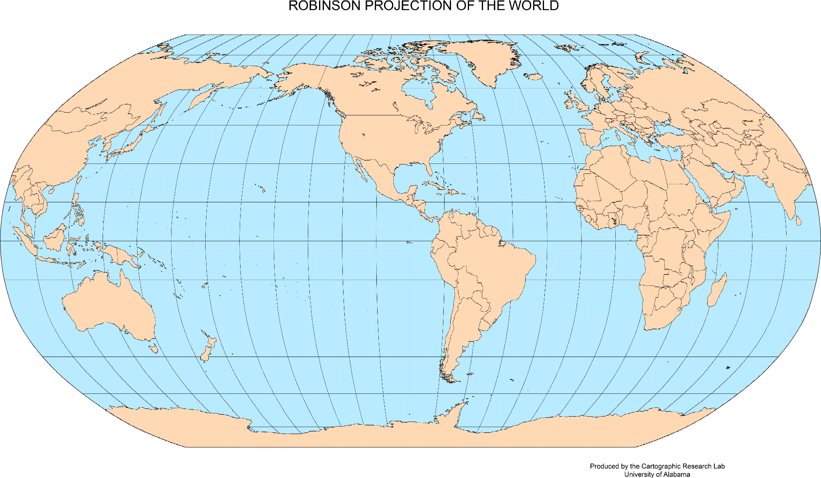
D3-geo: Projection
3D, Latitude, Longitude
2D, X, Y
Projection
The transformation of spherical coordinates (latitude and longitude) onto a two-dimensional plane, allowing the representation of a three-dimensional Earth on a flat surface.

Slide 35
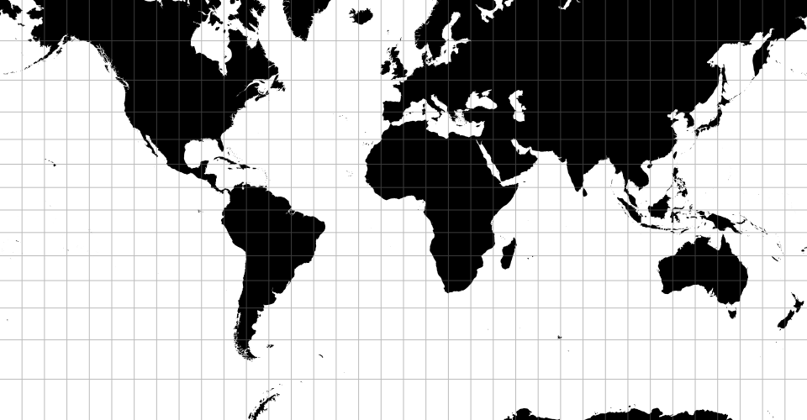
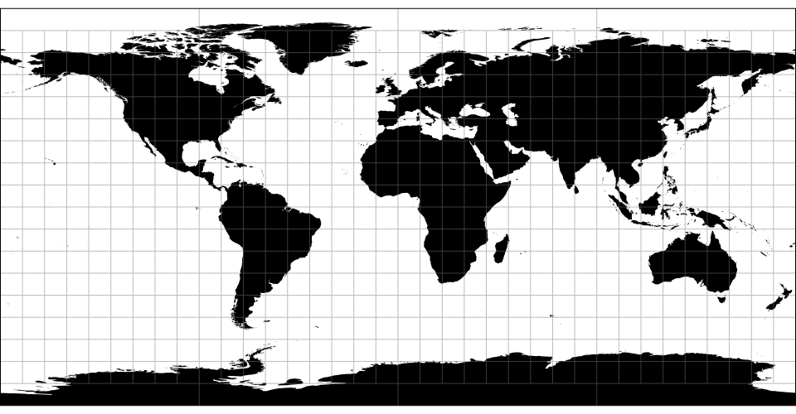

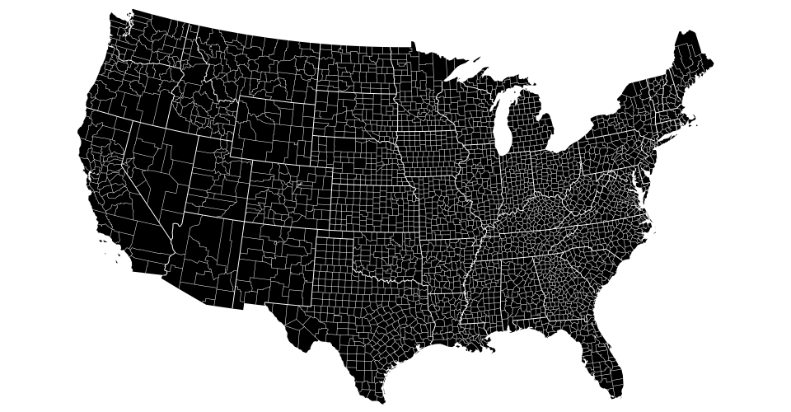
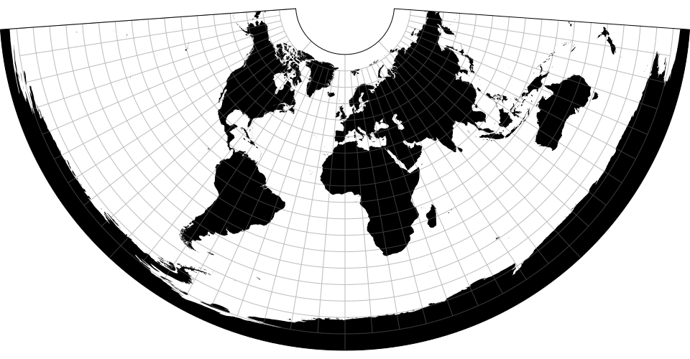
D3-geo: Projection
Mercator Projection: The Mercator projection is one of the most well-known projections and is often used for world maps. It preserves angles and straight lines but distorts the size of objects as they move away from the equator.
Equirectangular Projection: Also known as the Plate Carrée projection, it simply maps the latitude and longitude values directly onto the Cartesian coordinates, resulting in a rectangular map. This projection distorts shapes and areas, particularly near the poles.
Orthographic Projection: The orthographic projection displays the Earth as if viewed from a distant point in space. It is commonly used for globe-like visualizations, where the Earth is represented as a sphere.
Albers Projection: The Albers projection is a conic projection that balances shape and area distortions. It is often used for regional maps, such as country-level or state-level maps.
Conic Equidistant Projection: This projection preserves distances along a set of standard parallels, making it suitable for mapping specific regions or countries.

Slide 36
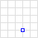
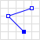
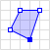
D3-geo: geoJson
{ "type": "Point", "coordinates": [30.0, 10.0] }
Sample of GeoJson
{
"type": "Feature",
"geometry": {
"type": "Polygon",
"coordinates": [
[
[0, 0],
[10, 0],
[10, 10],
[0, 10],
[0, 0]
]
]
},
"properties": {
"name": "Example Polygon",
"color": "blue"
}
}
"type": "Feature": Indicates that the GeoJSON object is a feature.
“FeatureCollection” allows array of “Feature”
"geometry": Defines the geometry of the feature.
"type": "Polygon": Specifies that the geometry type is a polygon.
"coordinates": Contains an array of coordinate values representing the vertices of the polygon. In this case, we have a square defined by a set of five coordinates.
"properties": Contains additional information associated with the feature.
"name": "Example Polygon": Specifies a name or label for the polygon.
"color": "blue": Represents an additional property like the color of the polygon.
{ "type": "LineString", "coordinates": [ [30.0, 10.0], [10.0, 30.0], [40.0, 40.0] ] }
Notes:
This is a simplified example, but it demonstrates the basic structure of a GeoJSON object. The "type" field specifies the type of GeoJSON object (e.g., "Feature", "Point", "LineString", “Polygon”.), and the "geometry" field defines the geometric shape and coordinates. Additional properties can be included in the "properties" field to store any relevant information or attributes associated with the feature. You can have multiple features within a GeoJSON feature collection, each with its own geometry and properties. This flexibility allows for the representation of more complex spatial data structures and enables the creation of rich and interactive map visualizations using D3.js.

Slide 37
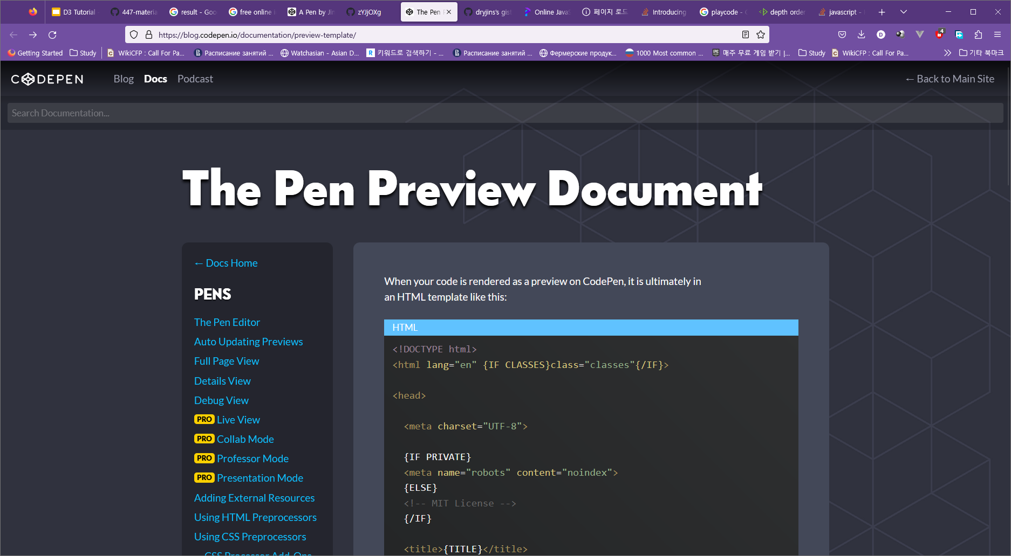

Web Development (environment)
Online Editor
Github
Codepen
https://codepen.io
Easy to access
Github gist support
Computation limit.
Github
https://github.com/
Version control
Easy to share your codes using Gist

Slide 38
Contents
Graphs & Trees (Shape & Layout)
Scrollytelling
Responsive Visualizations
Scalable Visualizations with Canvas
Annotations

Slide 39
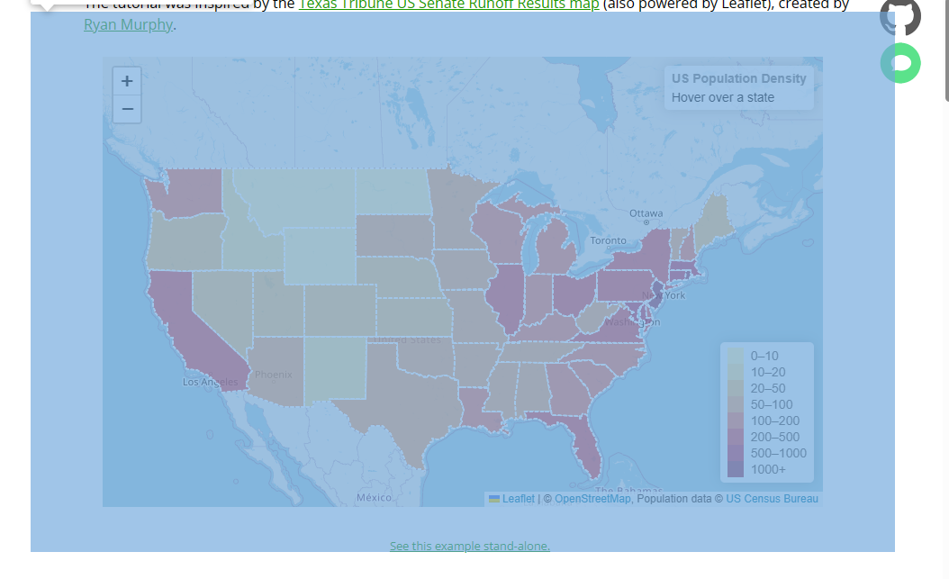

Leaflet + d3js
var svg = d3.select(map.getPanes().overlayPane).append("svg"),
g = svg.append("g").attr("class", "leaflet-zoom-hide");
Select SVG canvas in Leaflet
Use projection to transform geoJson to screen
function projectPoint(x, y) {
var point = map.latLngToLayerPoint(new L.LatLng(y, x));
this.stream.point(point.x, point.y);}
Previous practice!
d3-geo-leaflet · GitHub
Use d3js to create interaction
d3-geo-projection / D3 | Observable (observablehq.com)
D3 + Leaflet (ocks.org)

Slide 40

Graph & Trees
Introduction to Network Graphs
Network graphs, also known as force-directed graphs, visualize relationships between nodes as interconnected links.
D3.js provides powerful tools for creating interactive and visually appealing network graphs.
Building a Network Graph with D3.js
Data Structure: Represent nodes and links using an appropriate data structure, such as an array of objects.
Node and Link Elements: Create SVG elements for nodes and links based on the data structure.
Force Simulation: Utilize D3's force simulation to determine node positions and link forces.
Data Binding and Visualization: Bind the processed data to DOM elements and apply visual attributes using D3's selection and manipulation functions.
Customization and Interaction
Node Styling: Customize node size, color, shape, and labels to represent different entities or attributes.
Link Styling: Configure link width, color, and opacity to indicate the strength or type of connections.
Interactivity: Enable mouse events and interactions to highlight nodes, show tooltips, or trigger actions on user interaction.
Network Analysis and Layout Algorithms
Network Metrics: Calculate and analyze metrics such as degree centrality or betweenness centrality to gain insights into the network structure.
Layout Algorithms: Apply different layout algorithms like force-directed, hierarchical, or radial layouts to arrange nodes and links.
d3-force/README.md at v3.0.0 · d3/d3-force · GitHub
nodes
edges
Directed or Undirected

Slide 41

Graph & Trees
Attractive Force: This force pulls connected nodes closer together, encouraging them to be near each other. It helps maintain the connections and cohesion within the graph.
Repulsive Force: This force pushes nodes apart, preventing them from being too close to each other. It helps to avoid node overlap and maintain a visually balanced layout.
Link Force: This force acts along the links between nodes, influencing their length and tension. It helps maintain the desired link distance and can simulate springs or elastic connections.
The force simulation algorithm iteratively calculates and updates the forces acting on each node based on these principles.
The forces are then applied to the nodes, causing them to move in response.
This iterative process continues until the forces reach an equilibrium, resulting in a stable layout.
UBC-InfoVis/2021-436V-examples: d3-force-directed-graph - CodeSandbox

Slide 42


Graph & Trees
Introduction to D3 Dendrogram
Dendrograms are hierarchical tree diagrams that represent relationships between entities.
D3.js provides powerful tools for creating interactive and visually appealing dendrograms.
Key Features of D3 Dendrogram
Hierarchical Data Representation: Dendrograms excel at visualizing hierarchical relationships and tree structures.
Customizable Visual Elements: D3 Dendrogram allows customization of node shapes, colors, labels, and other visual attributes.
Interactive Exploration: Dendrograms created with D3.js offer interactive features like zooming, panning, and node collapsing/expanding.
Building a D3 Dendrogram
Data Preprocessing: Prepare the hierarchical data structure in a format compatible with D3 dendrogram requirements.
Layout Configuration: Define the size, spacing, and orientation of the dendrogram layout.
Data Binding and Visualization: Bind the processed hierarchical data to DOM elements, create SVG elements for nodes and branches, and apply visual attributes and interactivity.
d3-shape/README.md at v3.2.0 · d3/d3-shape · GitHub
Most basic radial dendrogram in d3.js (d3-graph-gallery.com)

Slide 43



Graph & Trees
const data = d3.hierarchy(rawData);
Data Preprocessing
d3-hierarchy/README.md at v3.1.2 · d3/d3-hierarchy · GitHub
Layout Configuration
node.x - the x-coordinate of the node
node.y - the y-coordinate of the node
Data Binding and Visualization
UBC-InfoVis/2021-436V-examples: d3-tidy-tree - CodeSandbox

Slide 44

ScrollyTelling
Scrollytelling is a technique that combines storytelling and data visualization in a scrolling narrative format.
Key Features:
Sequential Presentation: Content is divided into scenes or sections.
Scroll-Triggered Animations: Each scene is revealed or animated as the user scrolls.
Interactive Elements: Users can interact with the content and explore data visualizations.
Engaging User Experience: Combines narrative storytelling with data-driven visuals.
Benefits of Scrollytelling:
Enhanced Storytelling: Presents information in a cohesive and engaging narrative.
Data Exploration: Allows users to interactively explore data visualizations.
Guided Experience: Provides a guided and immersive experience for the audience.
Best Practices:
Planning the Narrative: Designing a clear and coherent story structure.
Visual Transitions: Smooth and well-timed animations between scenes.
Responsiveness: Ensuring the scrollytelling experience works well across devices.
User Feedback: Providing visual cues to guide users through the narrative.
Use Cases:
News articles, storytelling websites, data-driven presentations, and more.
Notes:
Definition: Scrollytelling is a technique that combines storytelling and data visualization in a scrolling narrative format. Key Features: Sequential Presentation: Content is divided into scenes or sections. Scroll-Triggered Animations: Each scene is revealed or animated as the user scrolls. Interactive Elements: Users can interact with the content and explore data visualizations. Engaging User Experience: Combines narrative storytelling with data-driven visuals. Benefits of Scrollytelling: Enhanced Storytelling: Presents information in a cohesive and engaging narrative. Data Exploration: Allows users to interactively explore data visualizations. Guided Experience: Provides a guided and immersive experience for the audience. Tools and Libraries: Various tools and libraries can facilitate Scrollytelling, such as D3.js, Scrollama, ScrollMagic, and more. Best Practices: Planning the Narrative: Designing a clear and coherent story structure. Visual Transitions: Smooth and well-timed animations between scenes. Responsiveness: Ensuring the scrollytelling experience works well across devices. User Feedback: Providing visual cues to guide users through the narrative. Use Cases: News articles, storytelling websites, data-driven presentations, and more.

Slide 45

ScrollyTelling
So You Want to Build A Scroller - Jim Vallandingham
function position() {
var pos = window.pageYOffset - 10;
var sectionIndex = d3.bisect(sectionPositions, pos);
sectionIndex = Math.min(sections.size() - 1, sectionIndex);
if (currentIndex !== sectionIndex) {
dispatch.active(sectionIndex);
currentIndex = sectionIndex;}}
Scroller
Window: pageYOffset property - Web APIs | MDN (mozilla.org)
Scroll detector
Waypoints (imakewebthings.com)
Event dispatcher
d3-transition
Slide changes
UBC-InfoVis/2021-436V-examples: d3-waypoints-scrollytelling - CodeSandbox

Slide 46


Responsive Visualization
Responsive Visualization
Adapting visualizations to different screen sizes
Responsive visualization is the practice of designing and developing visualizations that adapt and respond to different screen sizes, ensuring an optimal viewing experience across devices.
It focuses on creating visualizations that are flexible, scalable, and user-friendly, regardless of the device used to access them.
With the increasing use of smartphones, tablets, and various screen sizes, it's crucial to ensure that visualizations remain accessible and usable on any device.
Responsive visualizations allow users to interact with data and insights seamlessly, regardless of the screen real estate available.
By adapting to different screen sizes, responsive visualizations cater to a wider audience and enhance user engagement.
Better UX!

Slide 47

Responsive Visualization
Container
Container
Keep RATIO!
UBC-InfoVis/2021-436V-examples: d3-responsive-scatter-plot - CodeSandbox
1.Adaption container changes manually

Slide 48

Responsive Visualization - viewBox
Viewport: The visible area or canvas on which the SVG content is displayed. It is defined by the width and height attributes of the <svg> element.
ViewBox: An attribute of the <svg> element that defines the coordinate system and aspect ratio of the SVG content. It specifies the initial coordinate system and the boundaries of the content that should be visible within the viewport. The viewBox attribute takes four values: x, y, width, and height.
Scaling Scalable Vector Graphics (SVG) provide a powerful feature called the "viewBox" attribute.
The viewBox defines the coordinate system and aspect ratio of the SVG content, allowing for responsive scaling.
When the container size changes, the viewBox ensures that the visualization scales proportionally to fit the available space.
viewBox - SVG: Scalable Vector Graphics | MDN (mozilla.org)

Slide 49

Responsive Visualization - viewBox
The numbers min-x and min-y represent the top left coordinates of the viewport
Min-x, Min-y
Width, Height
<svg width="300" height="300" viewBox="0 0 1500 1500">
This means:
horizontal axis: 1500 (your width unit) = 300px => 1 (your width unit) = 300/1500px = 1/5px
vertical axis: 1500 (your height unit) = 300px => 1 (your height unit) = 300/1500px = 1/5px
Now all shapes in the svg will scale:
their widths scale to 1/5px (1/5 < 1 => scale down) comparing to the origin.
their heights also scale to 1/5px (1/5 < 1 => scale down) comparing to the origin
viewbox · GitHub

Slide 50

Scalable Visualization with Canvas
Introduction to Scalable Visualizations
Scalable visualizations refer to visual representations of data that can handle large datasets and dynamically adapt to different screen sizes.
While SVG (Scalable Vector Graphics) is commonly used for visualizations, Canvas provides an alternative approach with unique advantages.
const canvas = document.getElementById("canvas");
const ctx = canvas.getContext("2d");
ctx.fillStyle = "green";
ctx.fillRect(10, 10, 150, 100);
Canvas API - Web APIs | MDN (mozilla.org)

Slide 51

Scalable Visualization with Canvas
Advantages of Canvas for Scalable Visualizations
Performance and Rendering Efficiency
Canvas utilizes immediate mode rendering, allowing direct manipulation of pixel data.
It can handle large datasets more efficiently than SVG, making it suitable for complex and dynamic visualizations.
Flexibility and Customization
With Canvas, you have full control over every pixel, enabling custom rendering and advanced graphical effects.
It provides the flexibility to create unique visualizations and interactive experiences tailored to specific requirements.
Responsiveness and Interactivity
Canvas can handle real-time updates and interactions more efficiently, making it ideal for interactive visualizations.
It enables smooth animations, responsive transitions, and interactive features without sacrificing performance.
Space
Rendering Time
Objects
Complexity

Slide 52

Scalable Visualization with Canvas
Considerations for Using Canvas in Scalable Visualizations
Complexity and Learning Curve
Working with Canvas requires a solid understanding of JavaScript and graphics programming concepts.
It may have a steeper learning curve compared to SVG, but the flexibility and performance advantages make it worth considering.
Browser Compatibility
Canvas is widely supported in modern browsers but requires JavaScript to render and interact with the visualizations.
Ensure compatibility with target browsers and consider fallback options for older or non-supported browsers.
Use Cases and Examples
Canvas is well-suited for visualizations with large datasets, dynamic updates, complex animations, and custom graphical effects.
Showcase examples of scalable visualizations created with Canvas to inspire and demonstrate its capabilities.
UBC-InfoVis/2021-436V-examples: d3-canvas-scatter-plot - CodeSandbox

Slide 53

Scalable Visualization with Canvas
D3 and Canvas in 3 steps (freecodecamp.org)
Hidden Canvas
Canvas
Canvas
Binding
Custom tags
Overlapping
Capture Interaction from Canvas (mousemove)
Using mouse point, find the objects from hidden canvas
Update visualization based on the changes of hidden canvas

Slide 54

Annotations
Types of Annotations
Markers: Pointers, arrows, or symbols placed on specific data points or areas of interest.
Labels: Text annotations providing additional information or descriptions.
Lines and Connectors: Lines or paths connecting data points or groups, emphasizing relationships or comparisons.
Regions and Shapes: Shaded areas or shapes indicating specific regions or categories.
Functions of Annotations
Data Explanation: Annotations clarify complex data patterns or outliers, making the visualization more informative.
Emphasis and Focus: Annotations draw attention to key insights, trends, or important data points.
Storytelling: Annotations help narrate a story, guiding the audience through the visualization and providing context.
Design Considerations
Placement and Alignment: Annotations should be strategically placed to avoid clutter and ensure clear visual hierarchy.
Styling and Contrast: Annotations should be visually distinct from the data points, using color, font size, or other visual cues.
Interactivity: Interactive annotations allow users to toggle visibility or access additional information when needed.
UBC-InfoVis/2021-436V-examples: d3-annotated-line-chart - CodeSandbox
https://d3-annotation.susielu.com

Slide 55


Examples of real application of d3js + leaflet
S. Jin et al., "A Visual Analytics System for Improving Attention-based Traffic Forecasting Models," in IEEE Transactions on Visualization and Computer Graphics, vol. 29, no. 1, pp. 1102-1112, Jan. 2023, doi: 10.1109/TVCG.2022.3209462.
C. Lee et al., "A Visual Analytics System for Exploring, Monitoring, and Forecasting Road Traffic Congestion," in IEEE Transactions on Visualization and Computer Graphics, vol. 26, no. 11, pp. 3133-3146, 1 Nov. 2020, doi: 10.1109/TVCG.2019.2922597.

Slide 56
Structured Prompting for Data Visualization
When using AI tools like ChatGPT to assist with D3.js development, structuring your prompts according to the data visualization pipeline yields better results.
The Visualization Pipeline and Prompt Strategy
Stage-Based Prompting Approach
Prompt Structure Example:
I need a D3.js visualization that: 1. Data Manipulation: [describe data processing needs] 2. Visual Mapping: [describe visual encoding requirements] 3. Rendering: [specify rendering approach]
Data
Data
Manipulation
Visual Mapping (Design)
Rendering
Visualization

Slide 57
Kaggle Data Visualization Exercise
https://docs.google.com/document/d/12IynQxBxLK7qcemVdaV9DPIl2DpgacJ4tEqZrQE3wJg/edit?usp=sharing
Exercise Overview
Objective: Create an interactive D3.js visualization using a simple Kaggle dataset
Time: Approximately 20 minutes
Difficulty: Beginner-Intermediate
Dataset: "Chocolate Sales Data" (alternative options provided)
Submit the prompt (text format) and code with the compression: dryjins@gmail.com

Slide 58
Reference
Harvard's visualization course (CS171)
Codepen
D3.js
Starter project

